Slide 1
Step-by-step instructions for opening mobile apps to examine the data permissions and trackers inside

Slide 2
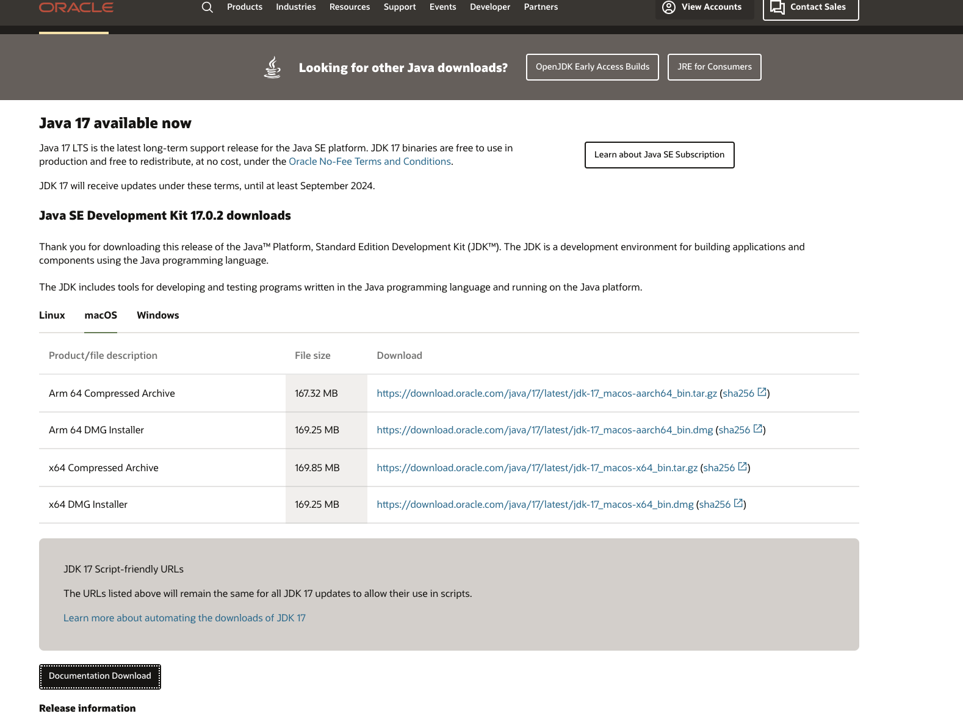
Step 1: JDK Download (Java Developer Kit):
https://www.oracle.com/technetwork/java/javase/downloads/index.html
Notes:
In this first step, go to the website above. Next, download the JDK. Choose the correct version for your computer either: macOS Installer or Windows x64 Installer.
Follow the installation instruction and then move on to the next slide.

Slide 3
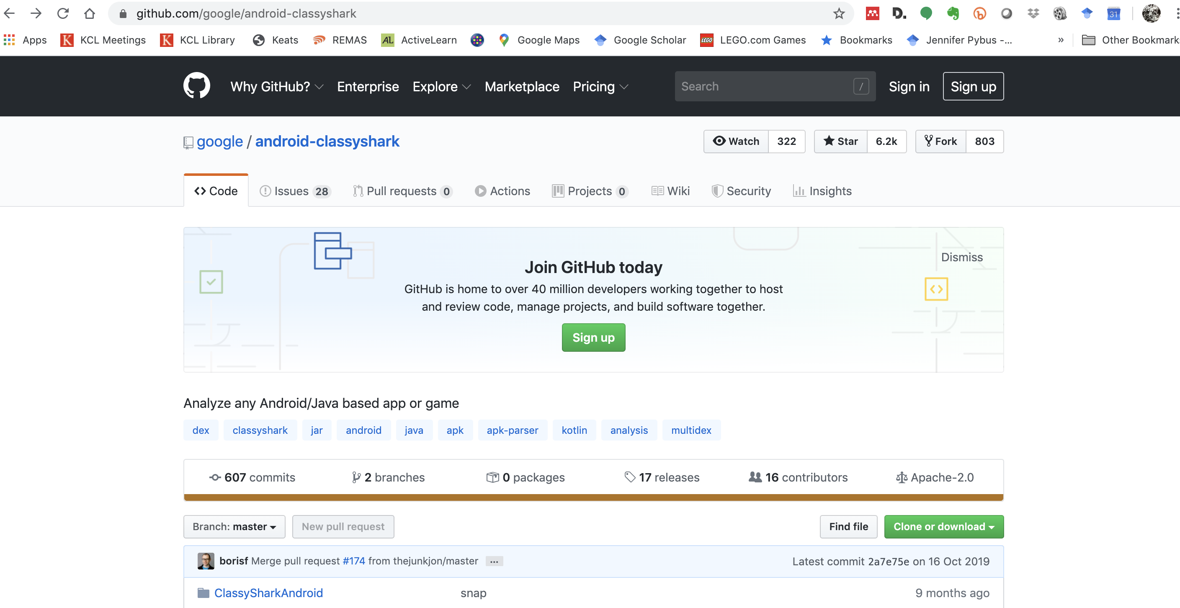
Step 2: Download ClassyShark
https://github.com/google/android-classyshark
Notes:
Follow the link to download classyshark. You needed the JDK download so that this programme will run on your computer. If this doesn’t work, go back to step and make sure you downloaded the JDK properly.
Scroll down to ‘download’

Slide 4
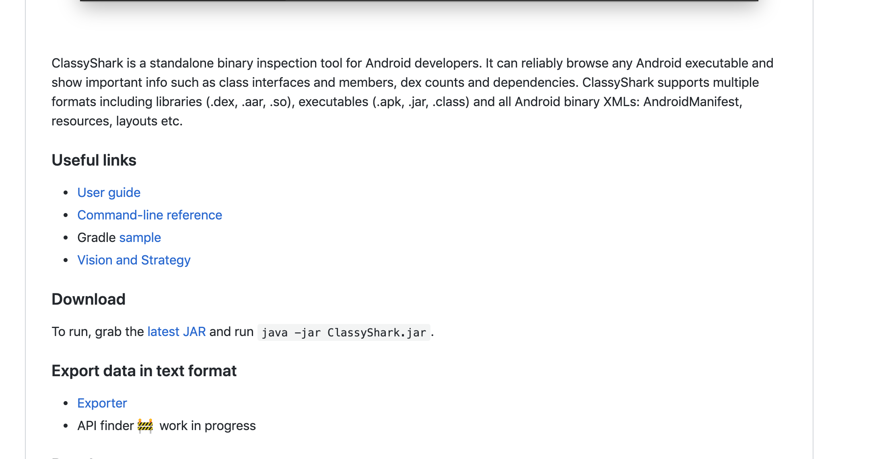
Click ‘latest JAR’

Slide 5
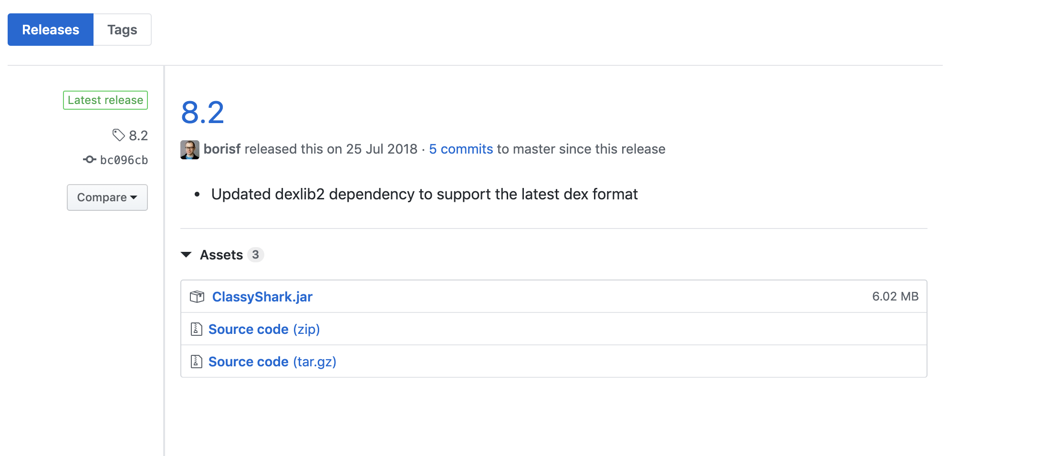
Download
Notes:
Follow the instructions for downloading ClassyShark. If you are having trouble opening it you may have to double click to allow (PC) or control click (Mac)

Slide 6
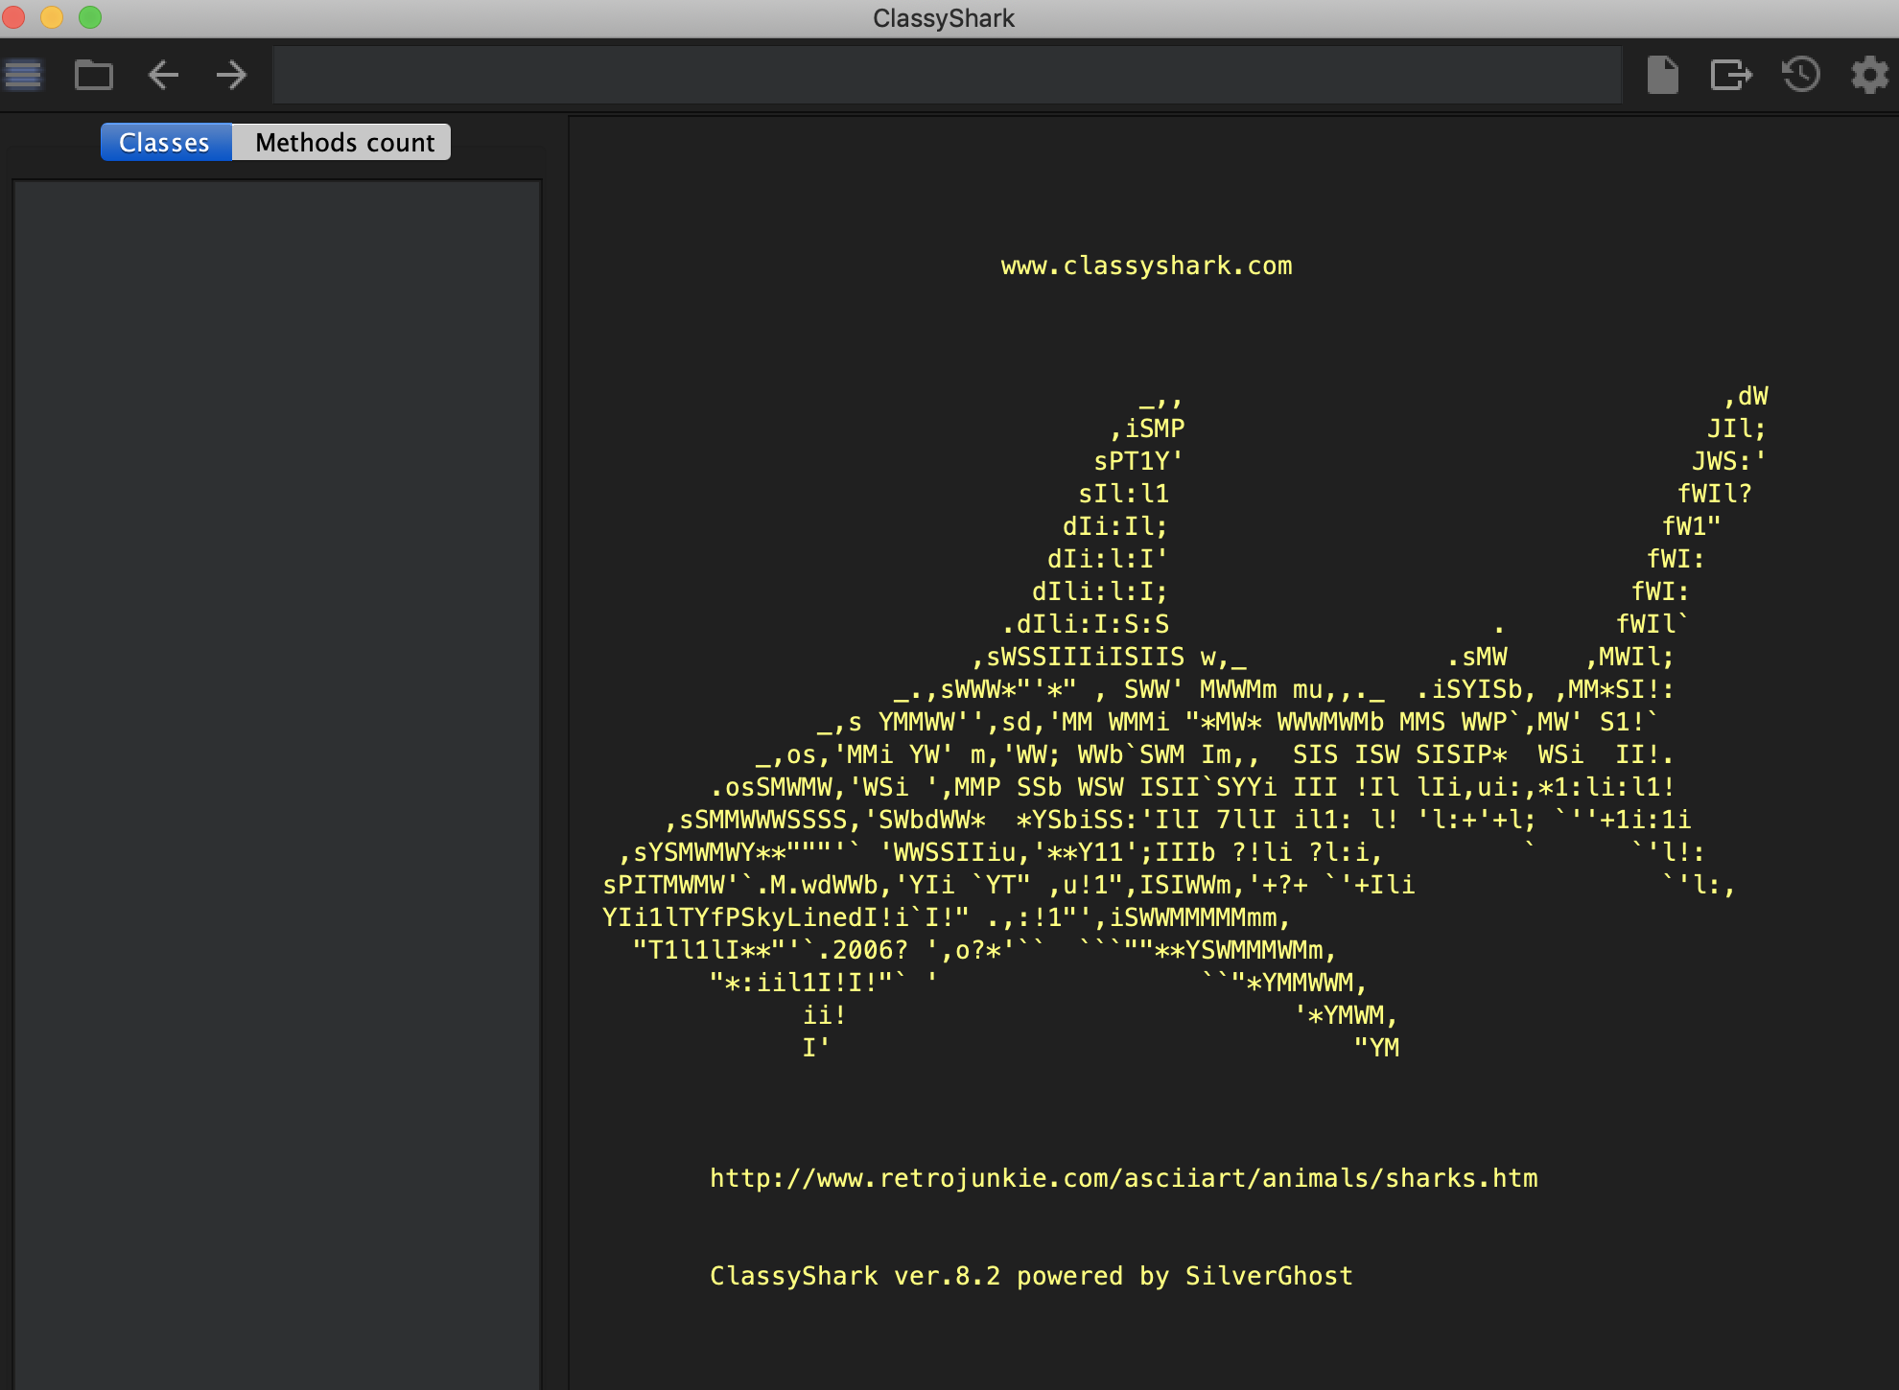
Notes:
When you open ClassShark you should see this.

Slide 7
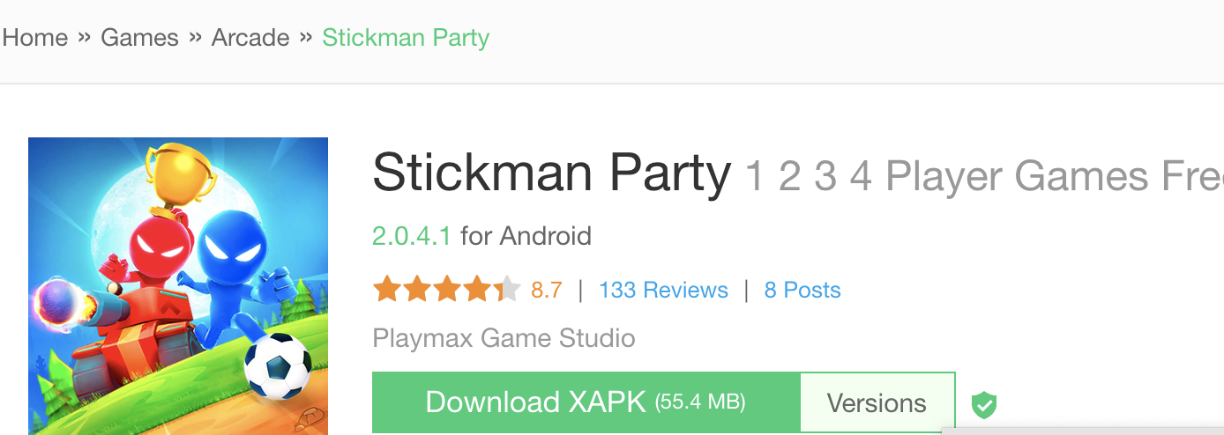
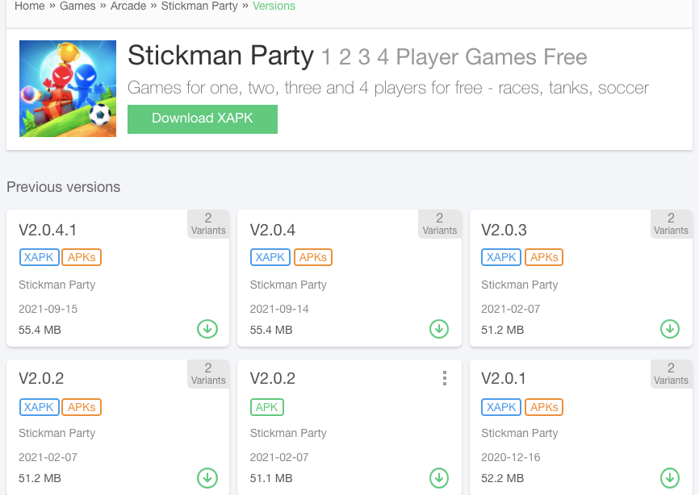
Step 3: Download an APK from APK Pure
https://apkpure.com/
Notes:
APK pure is a website that allows you to download any APK (android package), that is the entire contents of any mobile application. With the APK you can look inside and what kind of data your apps need in order to function.
NB Classshark only works with APK files NOT XAPK files. If you see an app like this, click on the versions to see if there is an APK version you can download instead like here.
To convert: XAPK.zip (add zip).

Slide 8
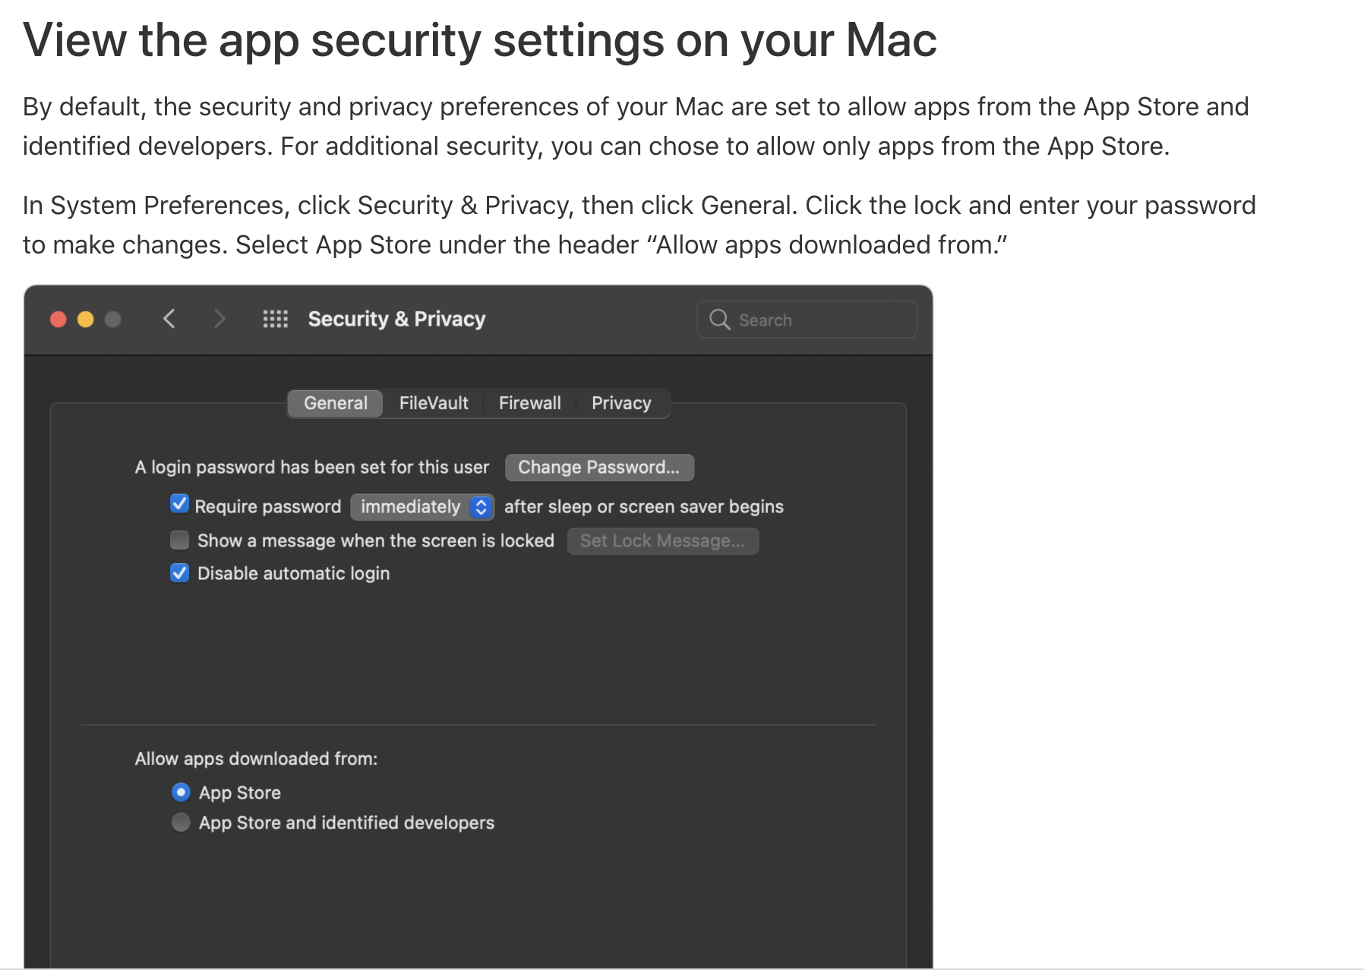
If iOS won’t download?
https://support.apple.com/en-us/HT202491

Slide 9
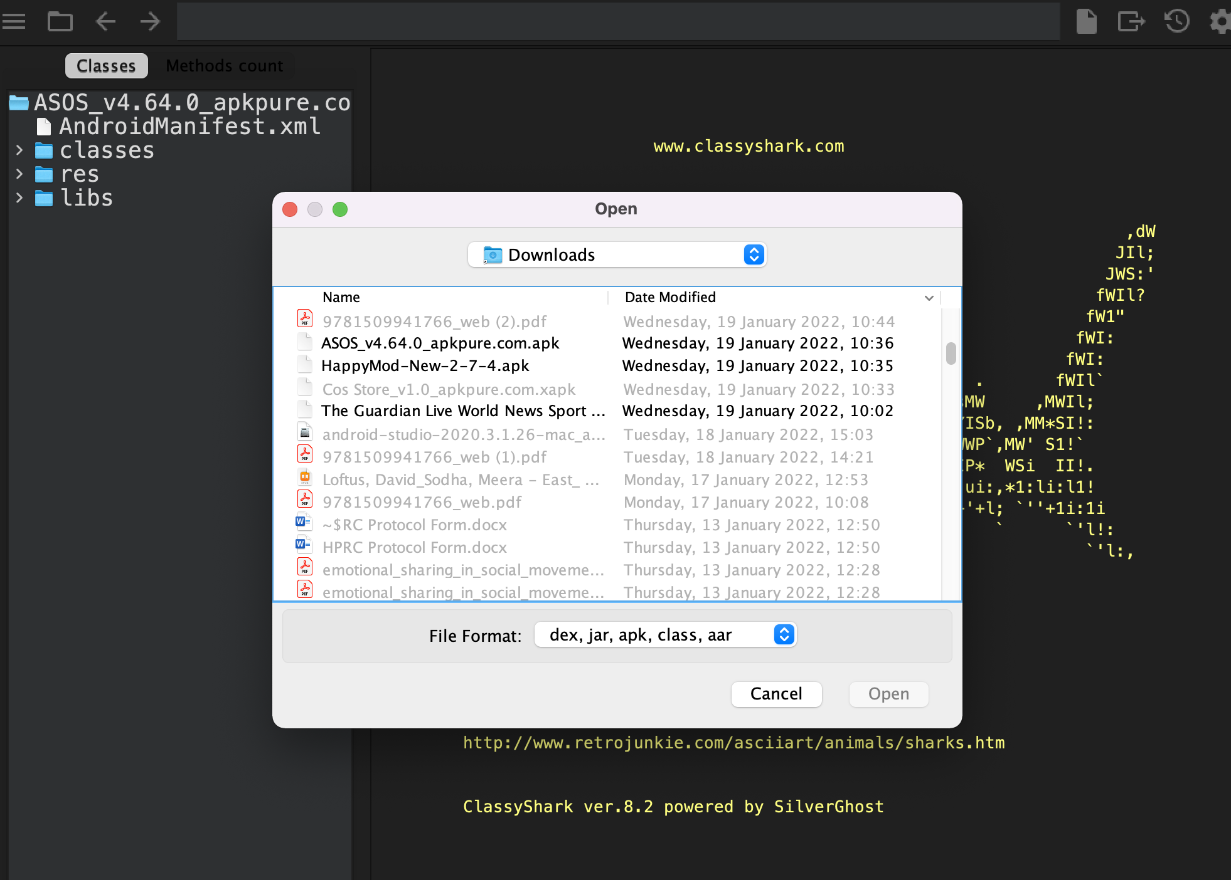
Step1: click folder
Step 2: click the APK you just downloaded
Step 3: Open

Slide 10
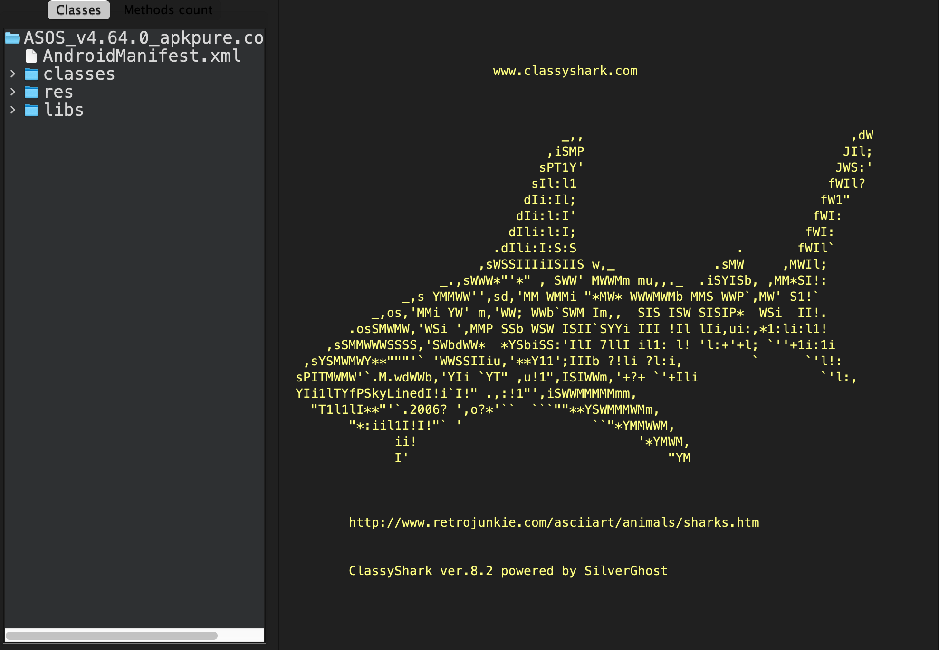
Notes:
If you have done everything right, you should end up with this screen.
Take note on the side of two important things:
Android Manifest – here you will find a list of all of the apps permissions: If you would like to see exactly what these permissions do and if they are classed as normal, dangerous or unknown: https://developer.android.com/reference/android/Manifest.permission#ACCEPT_HANDOVER
The classes folder: Inside this folder you will find all of the third party trackers that share personal data with the application. These are identified with .com next to them.

Slide 11
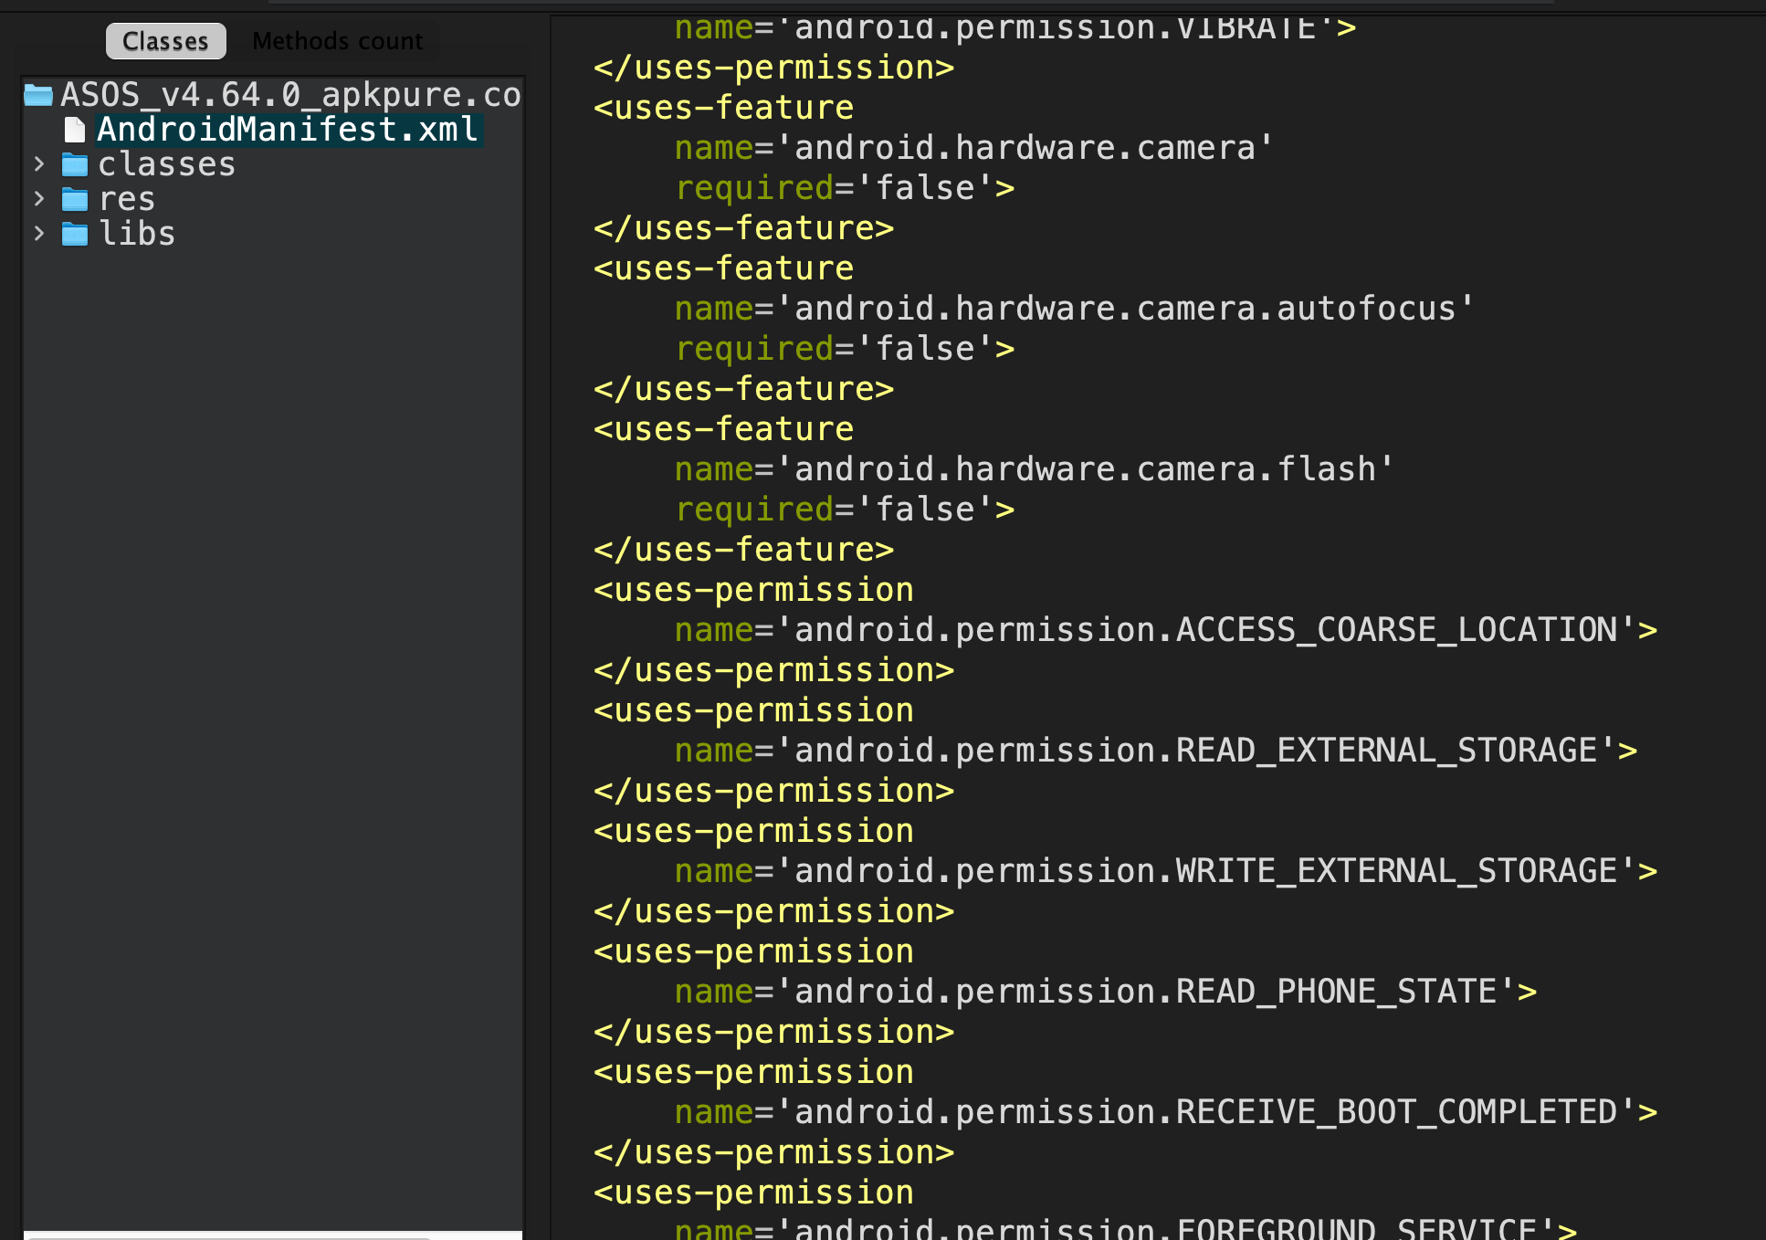
Looking at Manifests…
Notes:
Where you see ‘permission’ this is a data permission that the application has to gain access to your device. For example we can see that this app hasI the Internet permission.
But what is this? What does it mean?

Slide 12
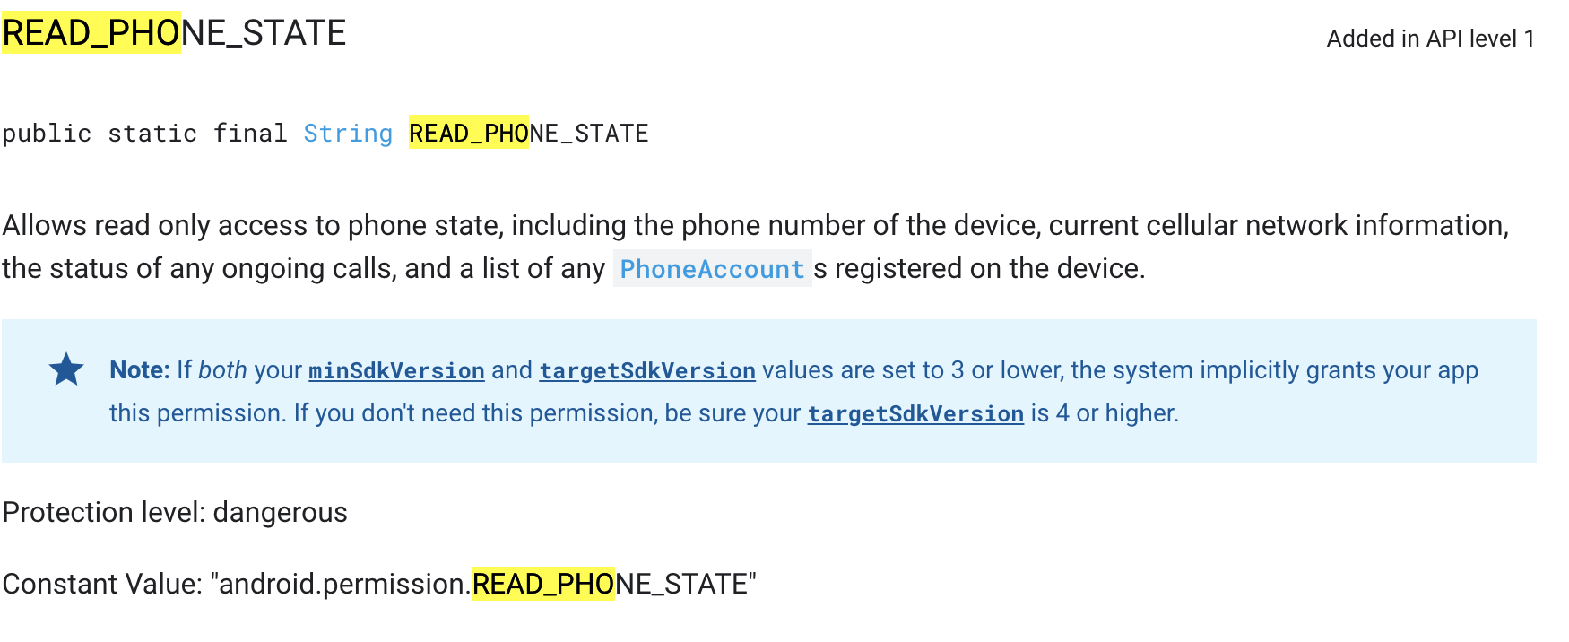
Understanding permissions
https://developer.android.com/reference/android/Manifest.permission#ACCEPT_HANDOVER

Slide 13
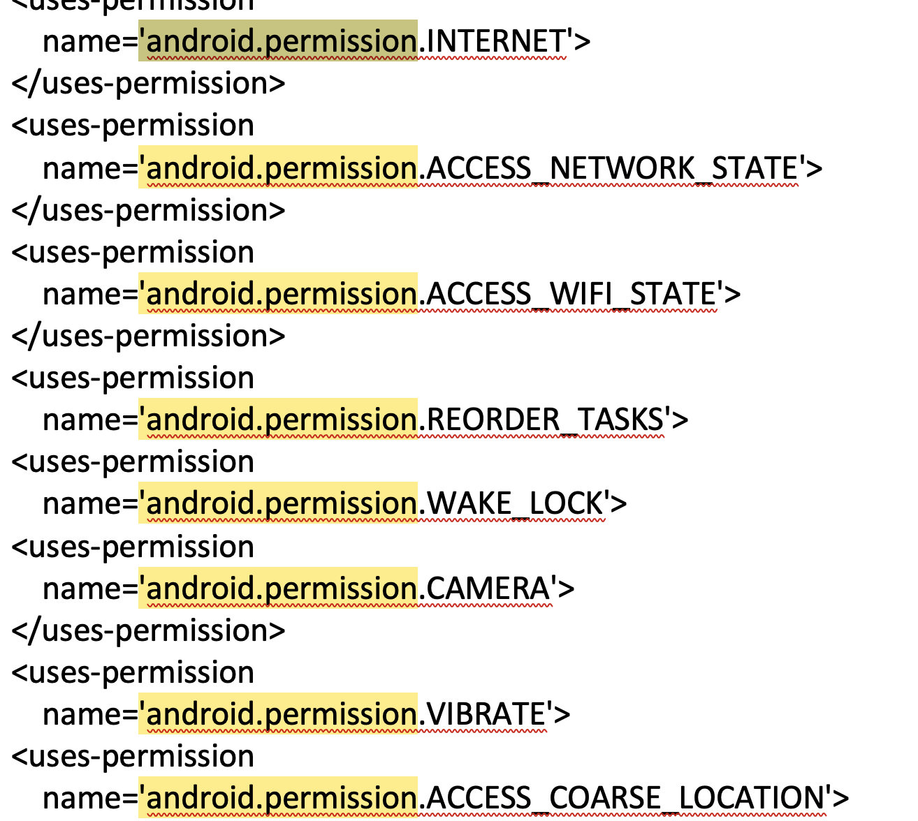
Manifests are a bit overwhelming…
Easiest way to pull out the manifest via ClassyShark is to copy the manifest and paste it into a word document. Then do a manual seach for ‘android.permission’.
This will highlight all permissions that you can then cross check with the android developer page.

Slide 14
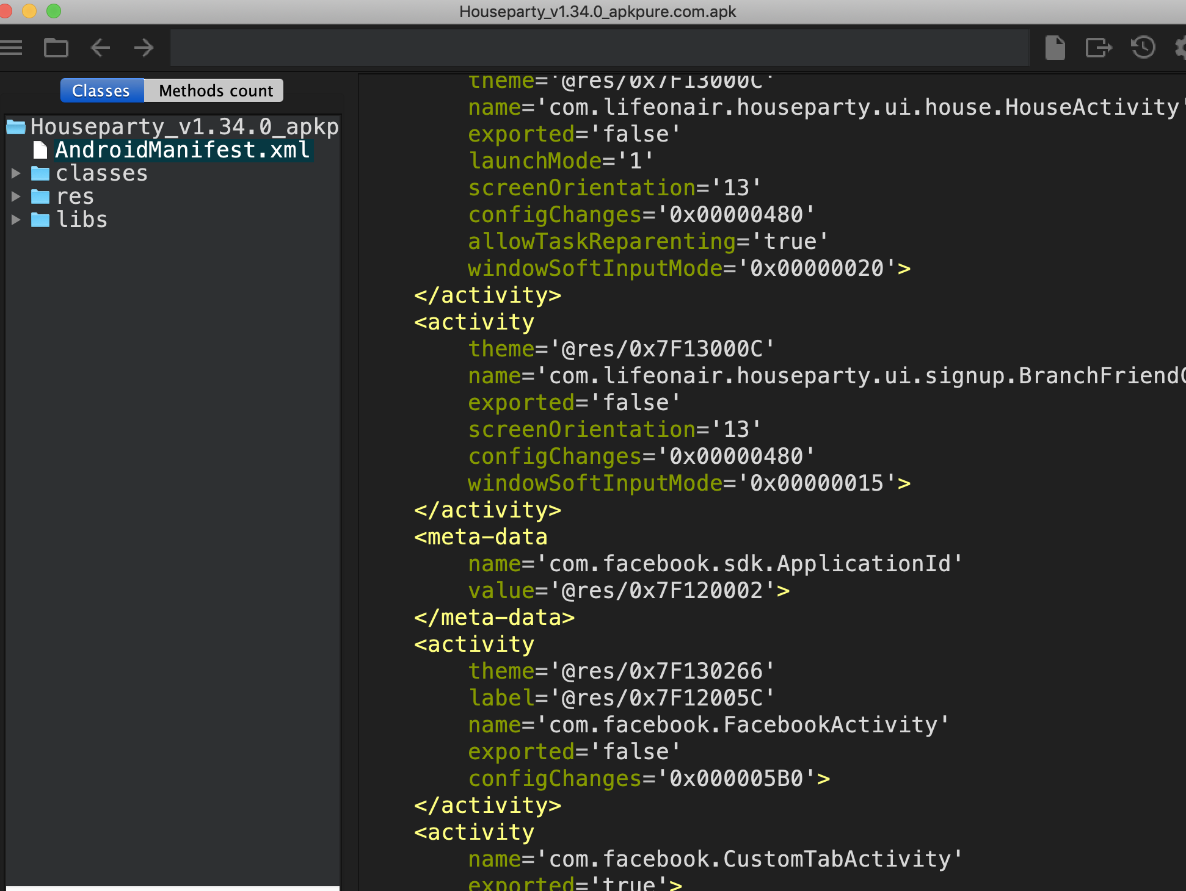
Manifests also show us activities, which give us clues about the trackers inside

Slide 15
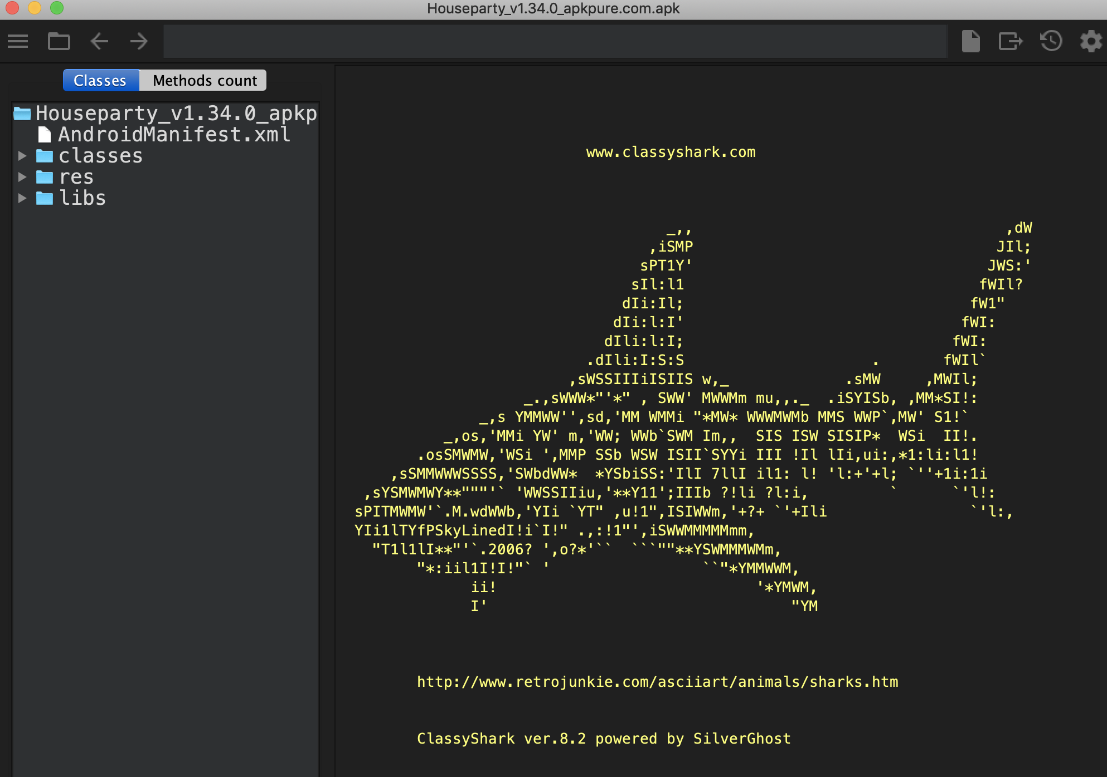

Slide 16
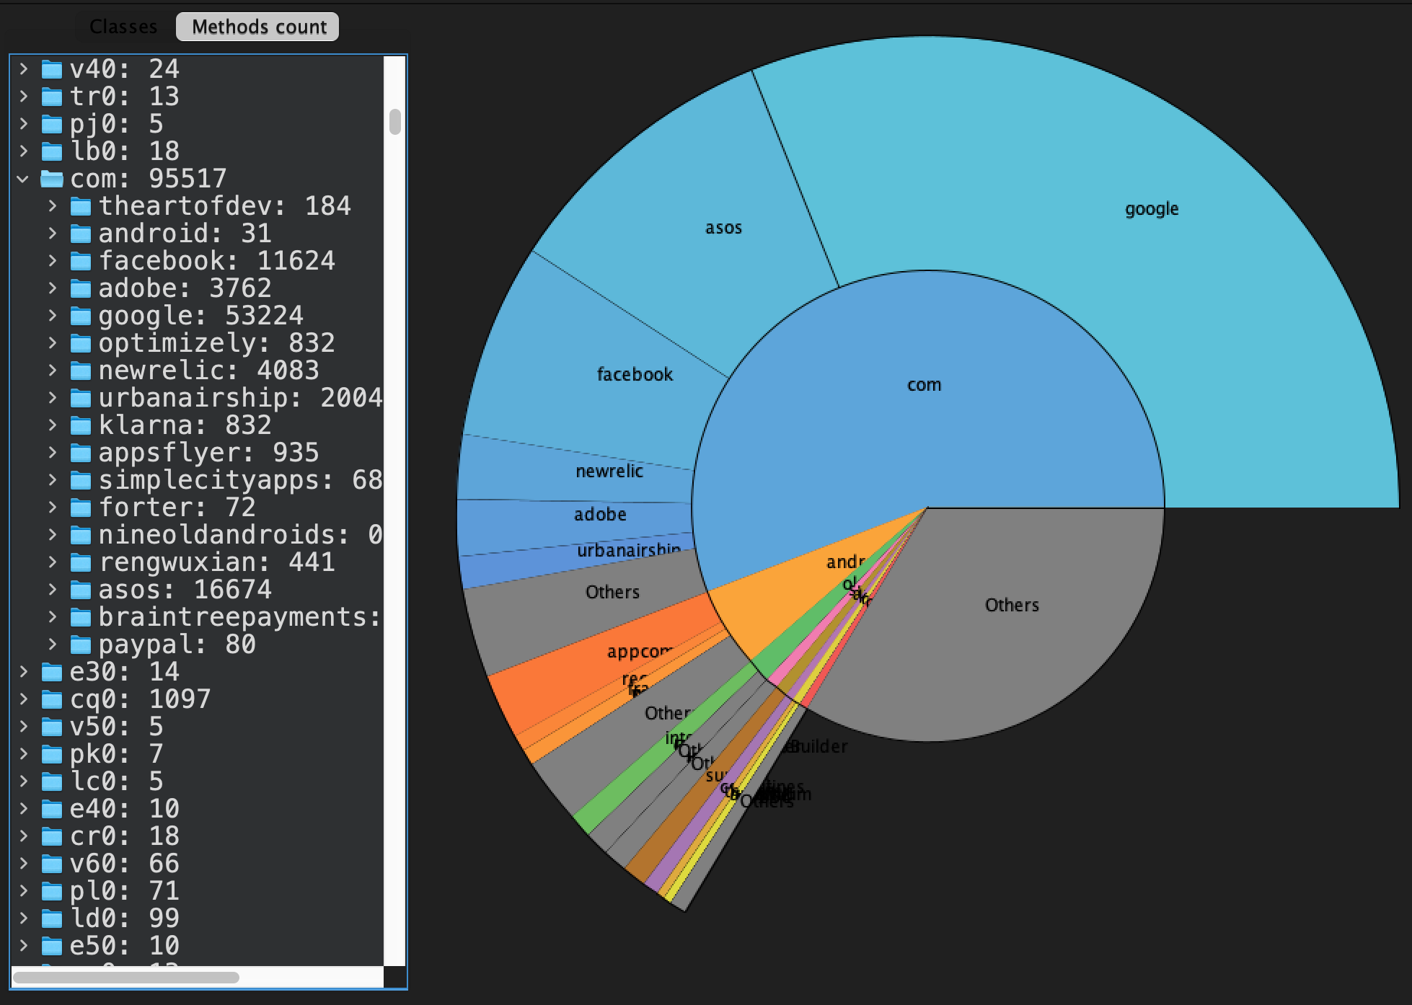
Notes:
Next you can look at the SDKs inside the the app. The easiest way to do this is to find the file called ‘com’ and open it up.
Here you can see a list of all the the SDKs.
In the visualization you can you see that the SDKs are all in Blue.

Slide 17
SDK Service Typology
App Development
Crash Reporting
Attribution
Analytics
Engagement
Advertising
Authentication
Social Networks
Payments

Slide 18
Notes:
Next you can look at the SDKs inside the the app. The easiest way to do this is to find the file called ‘com’ and open it up.
Here you can see a list of all the the SDKs.
In the visualization you can you see that the SDKs are all in Blue.

Slide 19
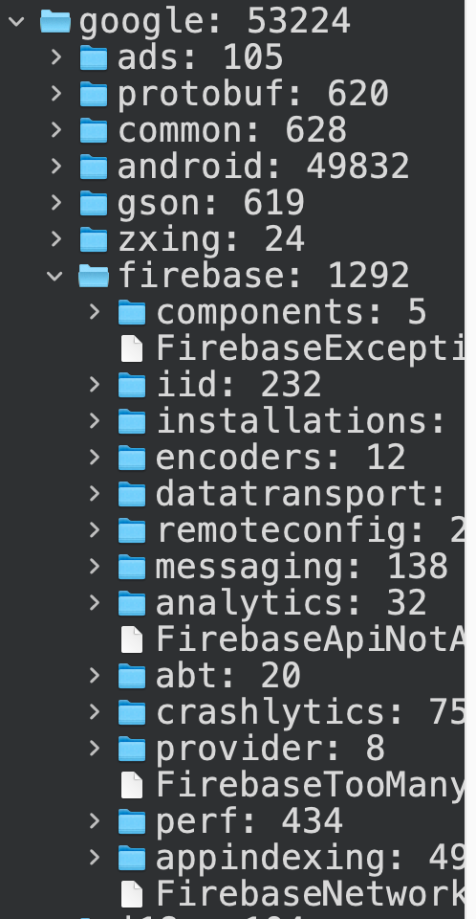
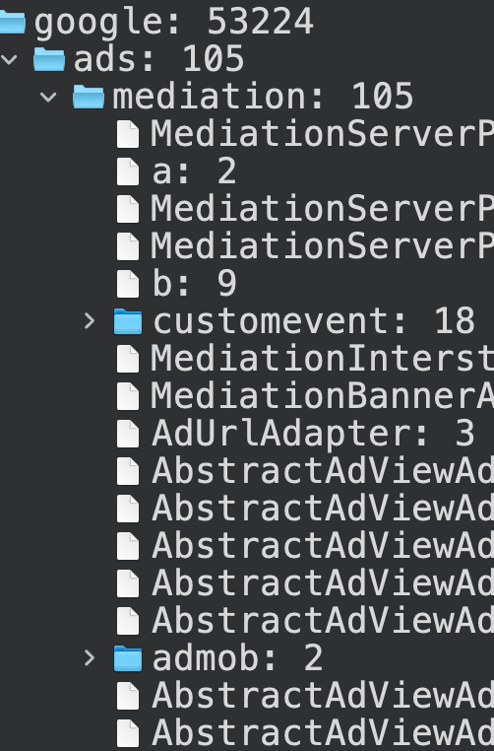

Slide 20
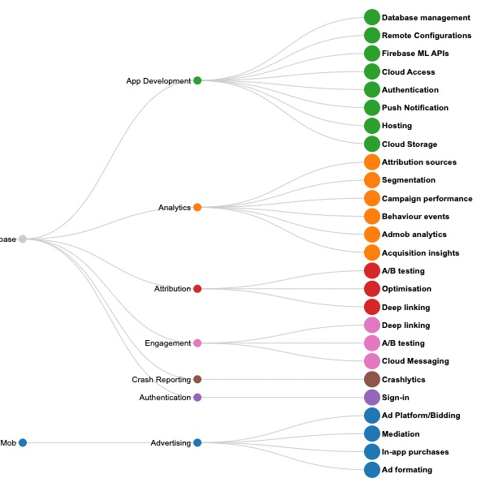

Slide 21
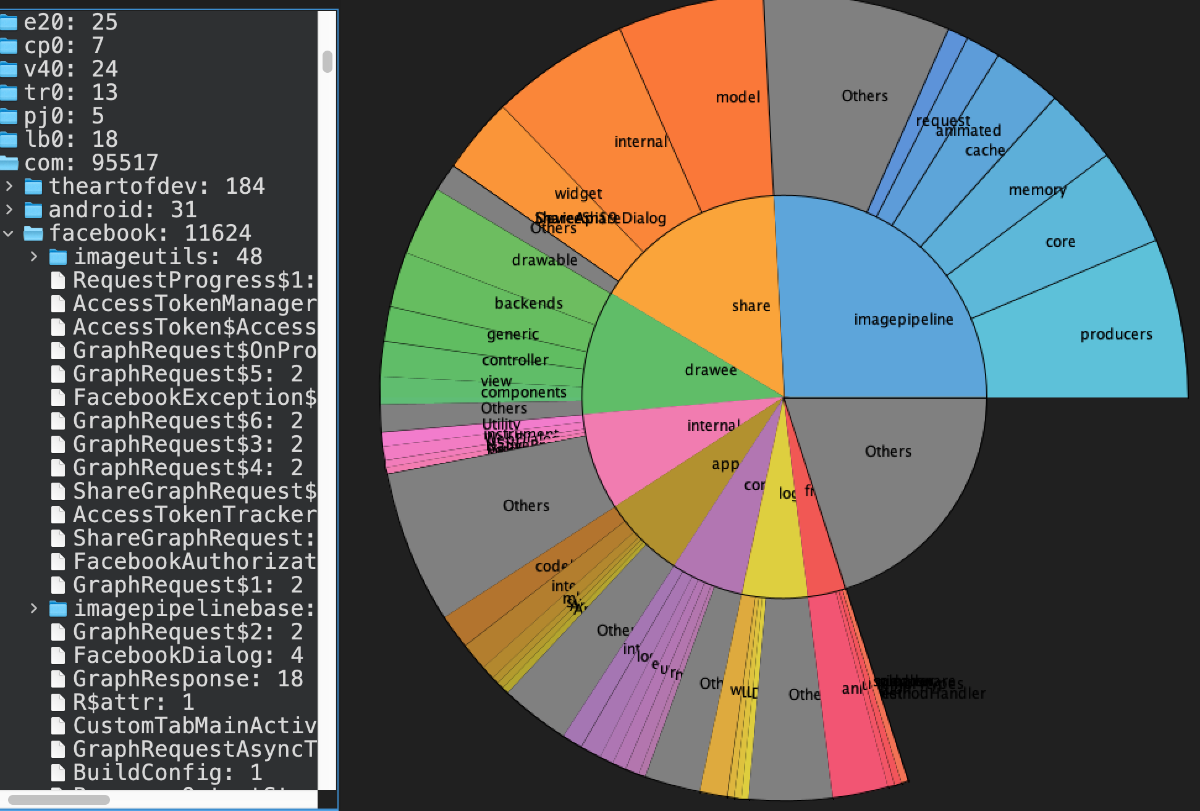
Notes:
Now we are inside the facebook SDK on the app.
What’s inside? Not all apps utilize the same resources: ASOS wants:
Facebook Share to make it easier for users to share what they like onto FB
Facebook Login: so that users can logon to ASOS via their FB account
Facebook App Events: which provides asos with a tool to measure user analytics and behaviour while they are inside the ASOS app—where do they go, what do they touch on, later on this can be used to serve you ads you based on what you were looking at, these may appear on your facebook feed
Then imagepipeline and drawee make it easy to move images from one place to another, ie the image of the shoes you were looking at on ASOS.

Slide 22
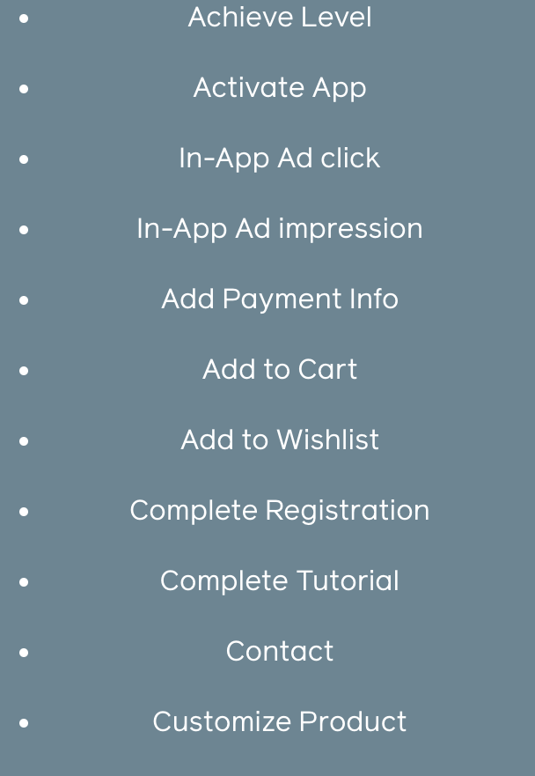
App Events are really important data for apps and SDKs. Here is a link to Facebook’s app event section of their SDK. Feel free to click and learn what kind of personal data gets gathered.
https://www.facebook.com/business/m/one-sheeters/app-events-overview

Slide 23
Notes:
Next you can look at the SDKs inside the the app. The easiest way to do this is to find the file called ‘com’ and open it up.
Here you can see a list of all the the SDKs.
In the visualization you can you see that the SDKs are all in Blue.

Slide 24
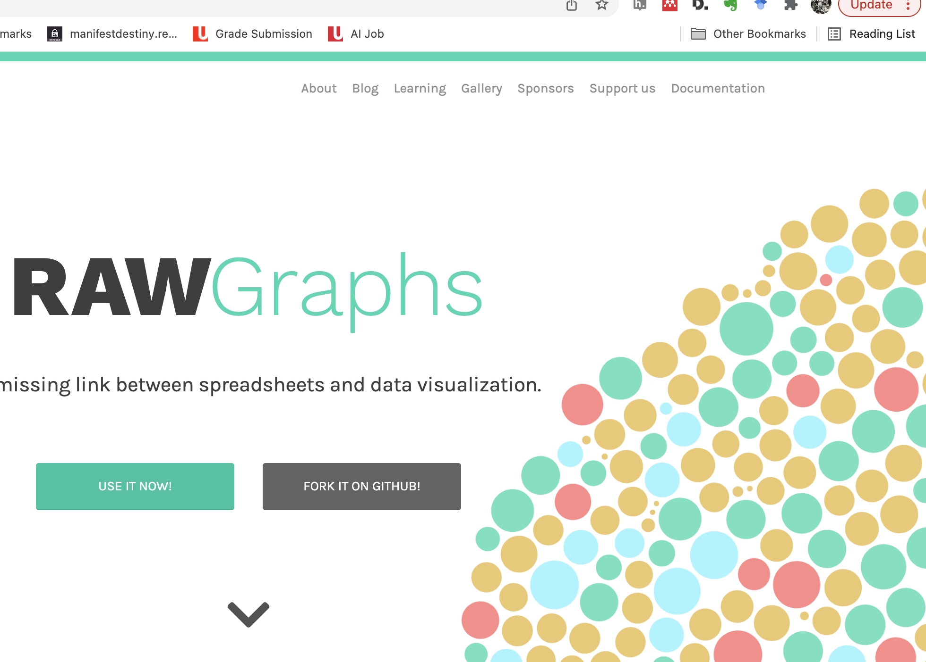

Slide 25
Project
Go through the slides
Download the APKs of 4 similar mobile apps (i.e. all running apps, period trackers, newspapers, games, etc…)
Determine what kind of permissions they have (normal, dangerous, unknown or system) by using either the Android Website or our https://manifestdestiny.reveb.la/ (see permission tab).
Determine which and how many trackers each of your apps have and what they do
Compare and analyse your results. You may want to visualize this with either https://app.rawgraphs.io/ or a network analysis Gephi. What new insight about these mobile apps can you draw based on your comparison and why?
Note: You will need to clean your data in a spreadsheet in order to visualise it.

